Slide 1
EF-EP-013
EPIC: General functions

Slide 2
EF-EP-013: General functions
Story ID: EP13-S001-JZ:
As a user, I want to be able to resume from where i left off, so that i can continue the application.
Story ID: EP13-S002-JZ:
As a user, I want the F&I to be able to continue the application process in DFE, so that i can continue the application.
Story ID: EP13-S003-JZ:
As an F&I, I want to be able to input information in DFE and sync to eApp, so that customer can continue the application on eApp.
Story ID: EP13-S004-JZ:
As a user, I want to be able to get support in eApp, so that I can get contact with BMW and get support.
Story ID: EP13-S005-JZ:
As a user, I want to be able to browse products after I applied one in eApp, so that I can see if there is anything new.
Story ID: EP13-S006-JZ:
As a user, I want to be able to cancel my application during process, so that I can quit the application and make other decisions.
Story ID: EP13-S007-JZ:
As eApp owner, I want to collect customer feedback, so that I can update the app to satisfy customers more.

Slide 3
Story ID: EP13-S001-JZ:
Business
As a user, I want to be able to resume from where i left off, so that i can continue the application.
Assumptions:
User can continue journey even not in dealer site.
User would like to apply from their own device.
Pre-Conditions:
There can be only one application at the same time.
Acceptance Criteria:
The application can be resumed with same login user.
The resumed application should contain all information user input for previous steps.
The application status should be saved and sync to DFE at each step.
IT

Slide 4
Story ID: EP13-S002-JZ:
Business
As a user, I want the F&I to be able to continue the application process in DFE, so that i can continue the application.
Assumptions:
User can continue journey even not in dealer site.
User may tired of inputting all information.
Pre-Conditions:
There can be only one application at the same time
User has gone through several steps
There is a button on the page, says “delegate to F&I”
Acceptance Criteria:
The application can be resumed with same application id
The resumed application should contain all information user input for previous steps and mapped in DFE
The application status should be saved and sync to DFE at each step
PBOC & OCR results are synced to DFE
IT

Slide 5
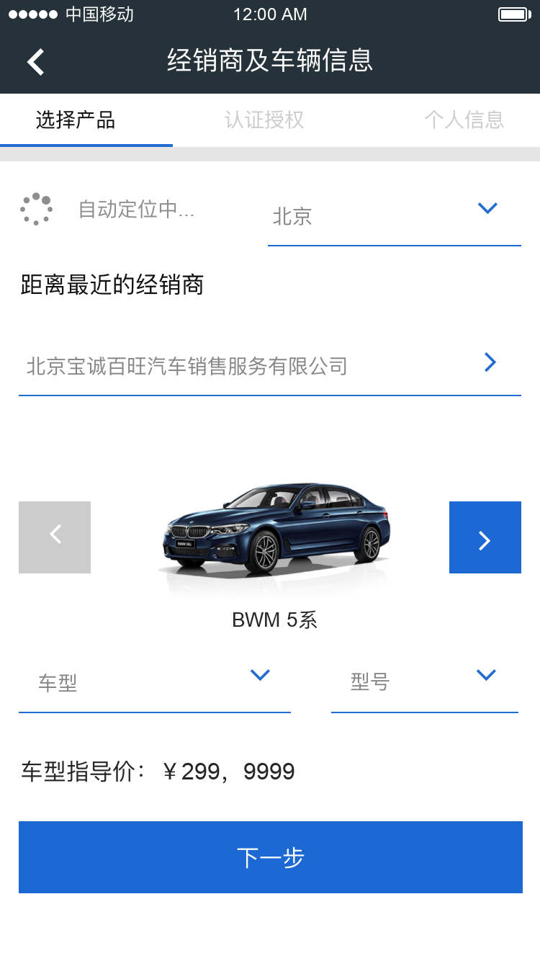

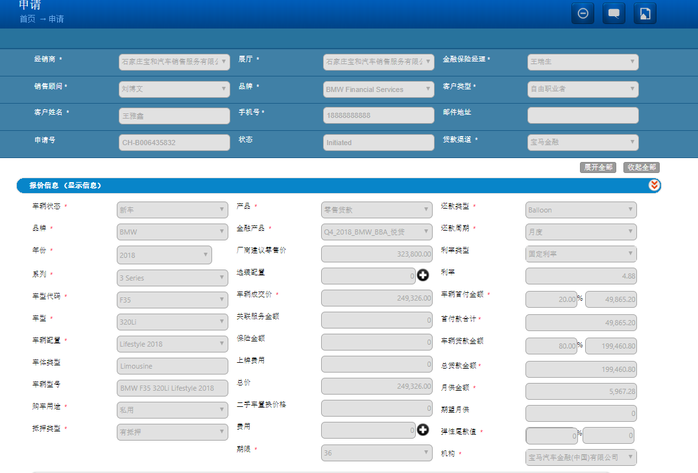
Story ID: ES-S000
Wireframes & Mockups:
北京
北京华德宝汽车销售服务有限公司
Click Next to sync to DFE
525i
M运动套装
Save
Customer input in eApp
Resume on DFE

Slide 6
Story ID: EP13-S003-JZ:
Business
As an F&I, I want to be able to input information in DFE and sync to eApp, so that customer can continue the application on eApp.
Assumptions:
User can continue journey even not in dealer site.
User would like to apply from their own device.
Pre-Conditions:
There can be only one application at the same time.
The F&I has finished inputting some information in DFE.
Acceptance Criteria:
The application can be resumed with any login user.
The resumed application should contain all information user input for previous steps.
The resumed application should apply to the first user who resumed this application and cannot be changed.
The application status should be saved and sync to DFE at each step.
IT
Security

Slide 7
Story ID: ES-S000
Wireframes & Mockups:
北京
Click Save to sync to eApp
北京华德宝汽车销售服务有限公司
525i
M运动套装
Save
F&I input in DEF
Resume on eApp

Slide 8
Story ID: EP13-S004-JZ:
Business
As a user, I want to be able to get support in eApp, so that I can get contact with BMW and get support.
Assumptions:
User can continue journey even not in dealer site.
User would like to apply from their own device.
User is having some questions.
Pre-Conditions:
None
Acceptance Criteria:
User can directly call BMW hotline in eApp.
IT

Slide 9
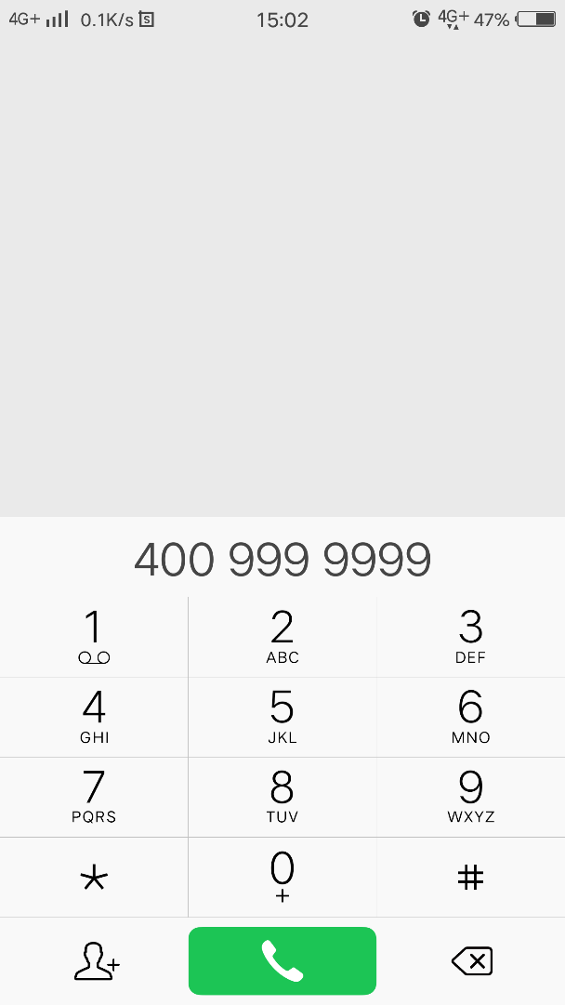

Story ID: ES-S000
Wireframes & Mockups:
Click float icon for help
Call out on cellphone

Slide 10
Story ID: EP13-S005-JZ:
Business
As a user, I want to be able to browse products after I applied one in eApp, so that I can see if there is anything new.
Assumptions:
User can continue journey even not in dealer site.
User would like to apply from their own device.
User is interested in new products and tends to choose a more suitable one.
Pre-Conditions:
The user has applied a product and the process is ongoing.
Acceptance Criteria:
User can switch between process page and product page at any time.
User can see products, but cannot apply for a new one unless he cancels ongoing one.
IT

Slide 11
Story ID: EP13-S006-JZ:
Business
As a user, I want to be able to cancel my application during process, so that I can quit the application and make other decisions.
Assumptions:
User can continue journey even not in dealer site.
User would like to apply from their own device.
User has changed his mind, and wants to cancel the application.
Pre-Conditions:
The user has applied a product and the process is ongoing.
Acceptance Criteria:
User can cancel the application at any step.
The application should be terminated in both eApp and DFE.
Notification should be sent to F&I and user himself.
IT

Slide 12


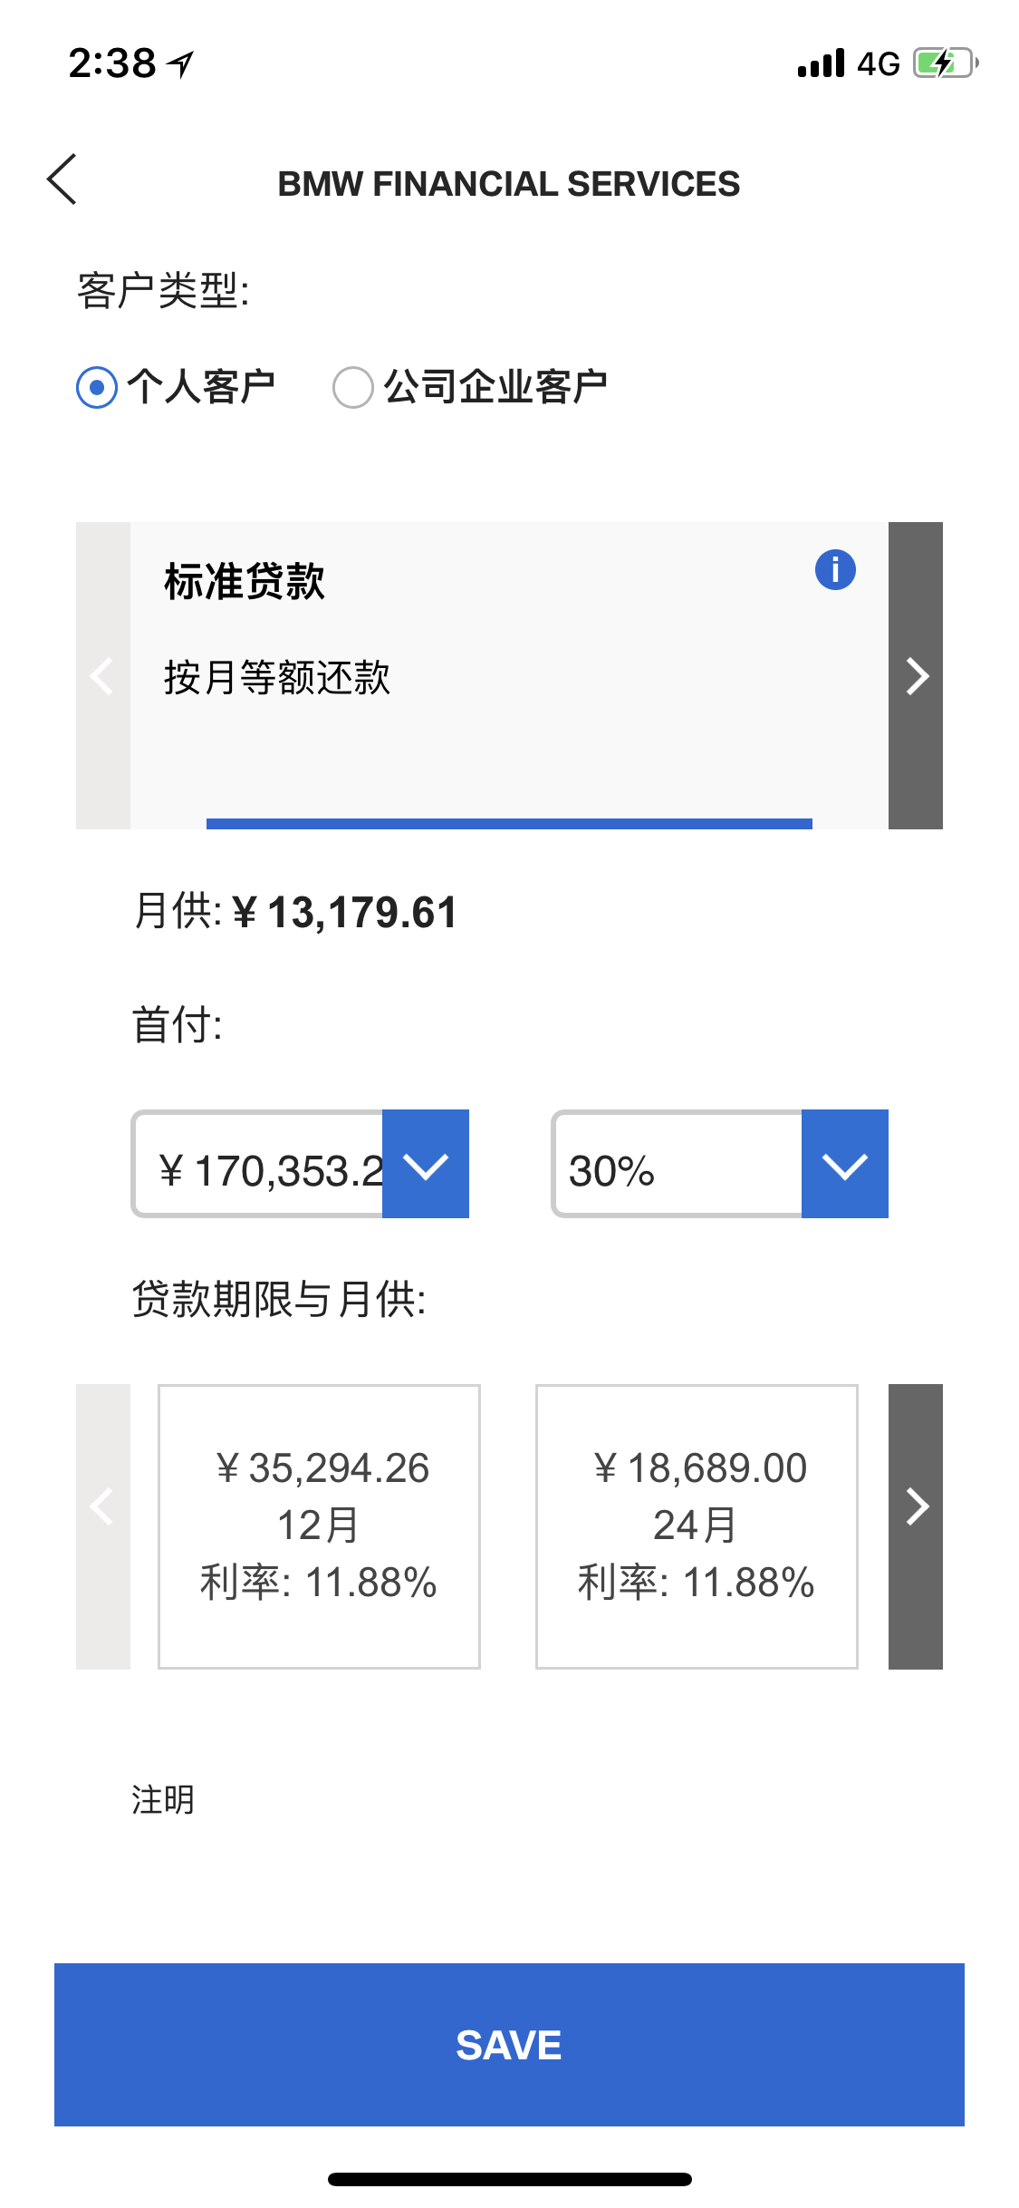
Story ID: ES-S000
Wireframes & Mockups:
Click the status bar on the top to resume to ongoing process
Status
Ongoing process status
Ongoing process status
Ongoing process status
Status page layout blablabla
You can’t proceed as you already have an ongoing process
Confirm
Cancel the application
Click Next to SF product
Click Next
Alert pops up to show it’s not able for user to go further

Slide 13
Story ID: EP13-S007-JZ:
Business
As eApp owner, I want to collect customer feedback, so that I can update the app to satisfy customers more.
Assumptions:
User can continue journey even not in dealer site.
User would like to feedback on eApp.
Pre-Conditions:
None.
Acceptance Criteria:
User can rate the app, and input comments for feedback.
Admin can see the ratings and feedbacks in backend.
IT

Slide 14

Story ID: ES-S000
Wireframes & Mockups:
Feedback
Please rate our app …
Suggestions to say …
Blablabla…
Submit
Click float icon for feedback
Input user feedback and rate

